Slide 1
Algebraic (Graph) Algorithms
(a little algebra goes a long way)
Jesper Nederlof
NETWORKS training week ‘19
Asperen

Slide 2
(Preliminary) Outline
Addition and Multiplication
Linear Algebra
(Bipartite) Perfect Matchings (`assignment problem’)
Short paths
Cliques
Set Cover
Steiner Trees
Finding Long Paths
Finding (short) Hamiltonian cycles (`Traveling Salesman Problem’)
If time left: A simple Probabilistically Checkable Proof for NP

Slide 3
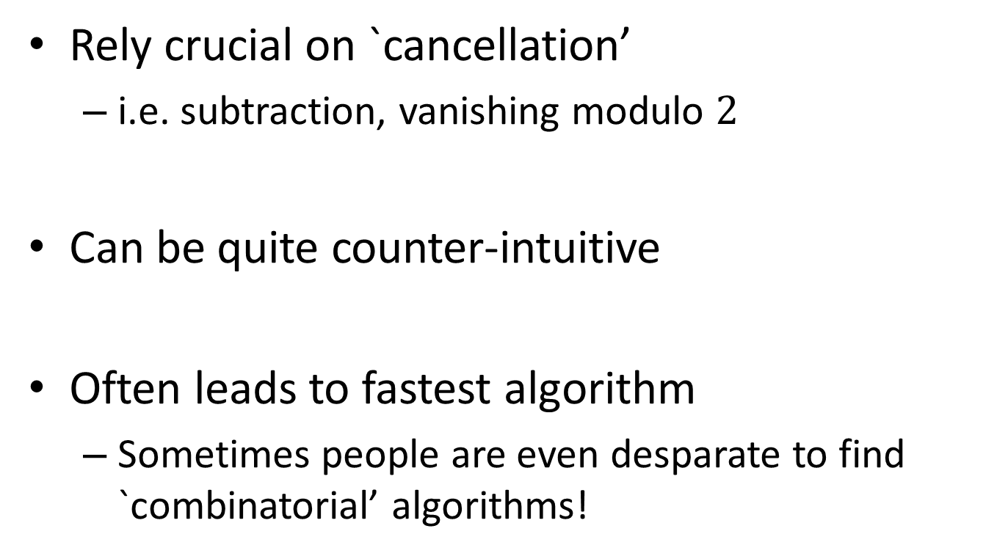
Algebraic Algorithms
Rely crucial on `cancellation’
  i.e. subtraction, vanishing modulo $2$
Can be quite counter-intuitive
Often leads to fastest algorithm
  Sometimes people are even desparate to find `combinatorial’ algorithms!

Slide 4
Arithmetic on primary school
How fast can we add or multiply two numbers on $n$ digits?
0001100
23958233 23958233
5830 + 5830 ×
---------- --------------
23964063 00000000 (=23,958,233× 0)
71874699 (=23,958,233× 30)
191665864 (=23,958,233× 800)
119791165 + (=23,958,233×5,000)
------------
139676498390 (=139,676,498,390)

Slide 5
Arithmetic on primary school
How fast can we add or multiply two numbers on $n$ digits?
0001100
23958233 23958233
5830 + 5830 ×
---------- --------------
23964063 00000000
71874699
191665864
119791165 +
--------------
139676498390

Slide 6
Arithmetic on primary school
How fast can we add or multiply two numbers on $n$ digits?
0001100
23958233 23958233
5830 + 5830 ×
---------- --------------
23964063 00000000
71874699
191665864
119791165 +
--------------
139676498390

Slide 7
Arithmetic on primary school
How fast can we add or multiply two numbers on $n$ digits?
0001100
23958233 23958233
5830 + 5830 ×
---------- --------------
23964063 00000000
71874699
191665864
119791165 +
--------------
139676498390

Slide 8
Arithmetic on primary school
How fast can we add or multiply two numbers on $n$ digits?
0001100
23958233 23958233
5830 + 5830 ×
---------- --------------
23964063 00000000
71874699
191665864
119791165 +
--------------
139676498390

Slide 9
Arithmetic on primary school
How fast can we add or multiply two numbers on $n$ digits?
0001100
23958233 23958233
5830 + 5830 ×
---------- --------------
23964063 00000000
71874699
191665864
119791165 +
--------------
139676498390

Slide 10
High school: complex numbers
(a+bi)*(c+di) = (ac-bd)+(ad+bc)i
Given a,b,c,d, compute (ac-bd) and (ad+bc).
How many multiplications are needed?
Only three! Try to find them if you want...
  Use M1 = ac, M2=bd, M3=…..
  Then
  (ac-bd) = M1-M2
  (ad+bc) = M3-ac-bd = M3-M1-M2

Slide 11
High school: complex numbers
(a+bi)*(c+di) = (ac-bd)+(ad+bc)i
Given a,b,c,d, compute (ac-bd) and (ad+bc).
How many multiplications are needed?
Only three! Try to find them if you want...
  Use M1 = ac, M2=bd, M3=(a+b)(c+d).
  Then
  (ac-bd) = M1-M2
  (ad+bc) = M3-ac-bd = M3-M1-M2

Slide 12
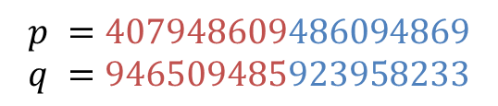





How fast can we multiply integers, really?
$$p_{1}$$
$$p_{0}$$
${p =p}_{1}{10}^{n/2}+p_{0}$
${q =q}_{1}{10}^{n/2}+q_{0}$
$pq=r_{2}{10}^{n}+r_{1}{10}^{n/2}+r_{0}$
$$r_{0}=p_{0}q_{0}$$
$$r_{1}=p_{1}q_{0}+p_{0}q_{1}$$
$$r_{2}=p_{1}q_{1}$$
Reduces $n$-bit mults to only four $n/2$ bit mults
Use recursively to get $4^{\log_{2}{n}}=n^{2}$ time
$$p =407948609486094869$$
$$q =946509485923958233$$
$$q_{1}$$
$$q_{0}$$

Slide 13
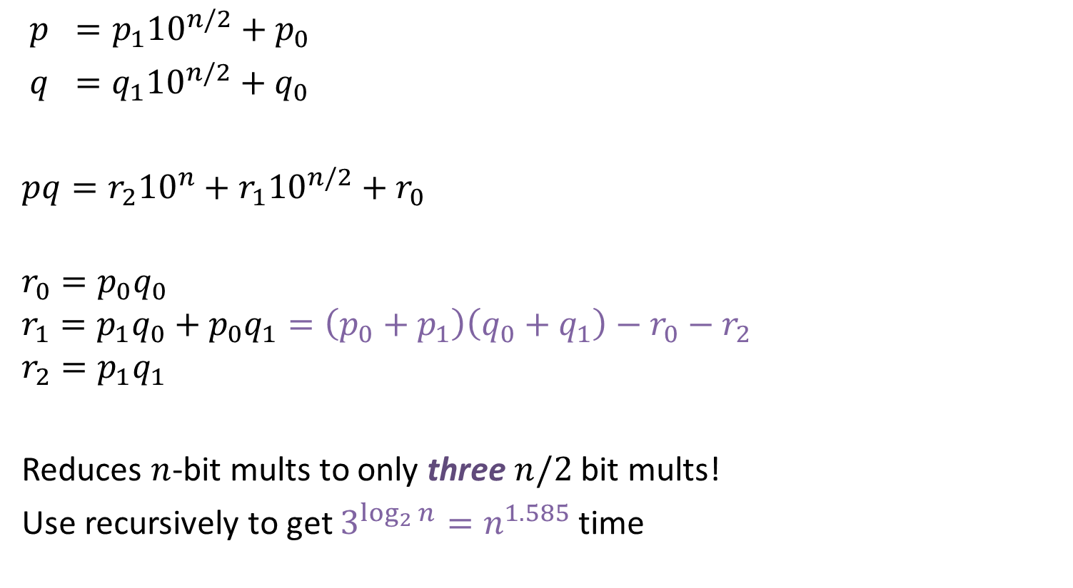
How fast can we multiply integers, really?
$$p_{1}$$
$$p_{0}$$
${p =p}_{1}{10}^{n/2}+p_{0}$
${q =q}_{1}{10}^{n/2}+q_{0}$
$pq=r_{2}{10}^{n}+r_{1}{10}^{n/2}+r_{0}$
$$r_{0}=p_{0}q_{0}$$
$$r_{1}=p_{1}q_{0}+p_{0}q_{1}=\left(p_{0}+p_{1}\right)\left(q_{0}+q_{1}\right)−r_{0}−r_{2}$$
$$r_{2}=p_{1}q_{1}$$
Reduces $n$-bit mults to only three $n/2$ bit mults!
Use recursively to get $3^{\log_{2}{n}}=n^{1.585}$ time
$$p =407948609486094869$$
$$q =946509485923958233$$
$$q_{1}$$
$$q_{0}$$

Slide 14
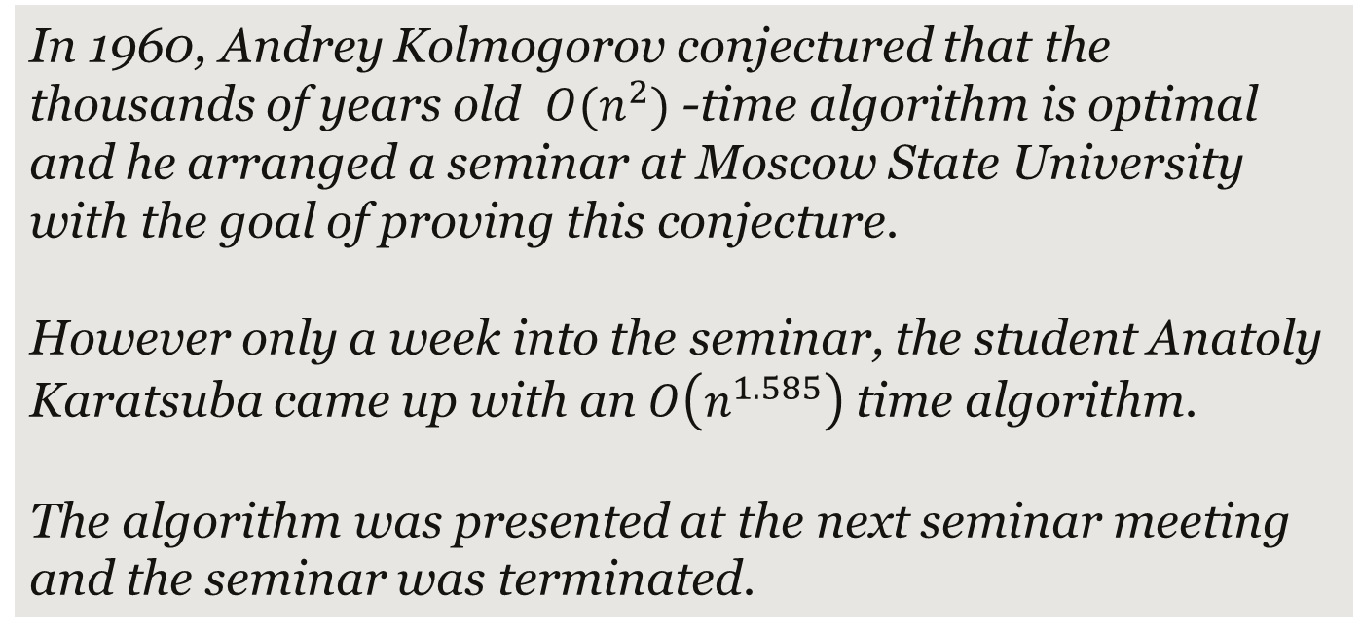
Karatsuba
In 1960, Andrey Kolmogorov conjectured that the thousands of years old $O(n^{2})$ -time algorithm is optimal and he arranged a seminar at Moscow State University
with the goal of proving this conjecture.
However only a week into the seminar, the student Anatoly Karatsuba came up with an $O\left(n^{1.585}\right)$ time algorithm.
The algorithm was presented at the next seminar meeting and the seminar was terminated.
There is a long history in complexity theory where guesses of the form “The obvious algorithm is optimal” have failed.
There

Slide 15

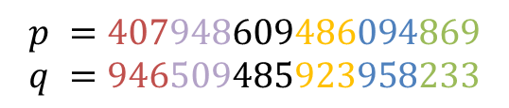

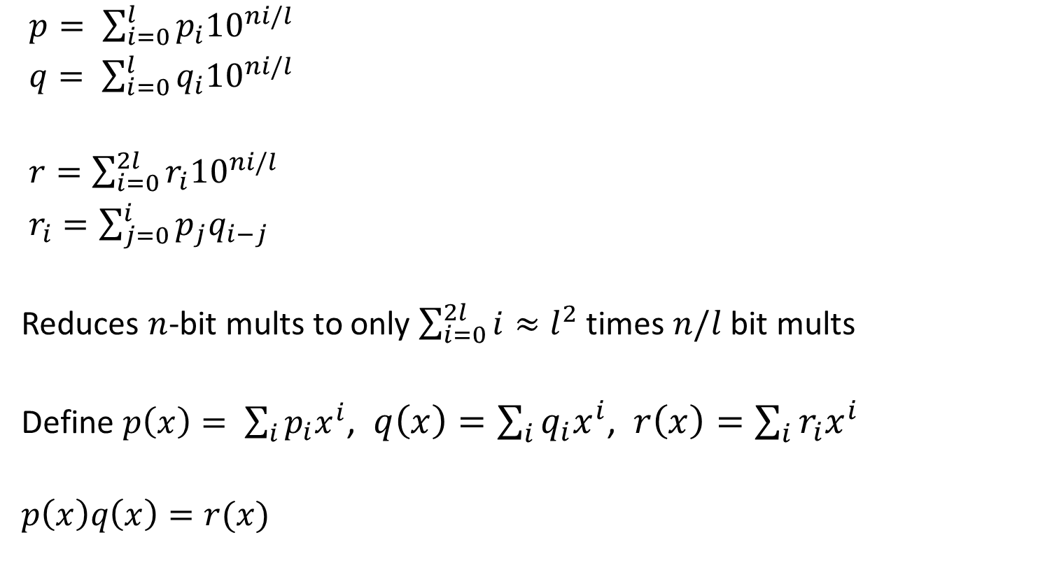






How fast can we multiply integers, really?
$$p_{l}$$
$$p_{l−1}$$
$$p_{1}$$
$$p_{0}$$
$p= \sum_{i=0}^{l}{p_{i}{10}^{ni/l}}$
$q= \sum_{i=0}^{l}{q_{i}{10}^{ni/l}}$
$r=\sum_{i=0}^{2l}{r_{i}{10}^{ni/l}}$
$r_{i}=\sum_{j=0}^{i}{p_{j}q_{i−j}}$
Reduces $n$-bit mults to only $\sum_{i=0}^{2l}{i}≈l^{2}$ times $n/l$ bit mults
Define $p\left(x\right)= \sum_{i}{p_{i}x^{i}}$, $q\left(x\right)=\sum_{i}{q_{i}x^{i}}$, $r\left(x\right)=\sum_{i}{r_{i}x^{i}}$
$$p\left(x\right)q\left(x\right)=r(x)$$
$$p =407948609486094869$$
$$q =946509485923958233$$
$$q_{l}$$
$$q_{l−1}$$
$$q_{1}$$
$$q_{0}$$

Slide 16
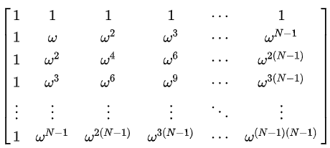
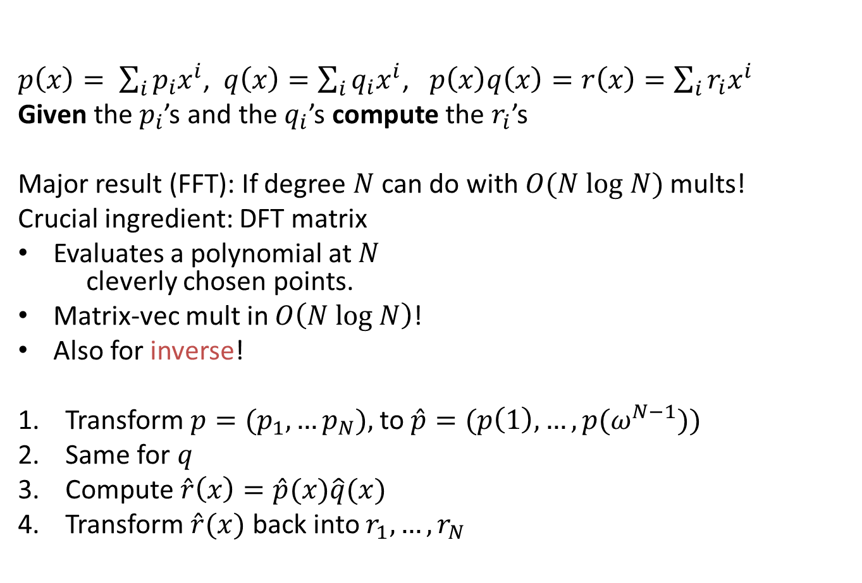

How fast can we multiply integers, really?
polynomials
$p\left(x\right)= \sum_{i}{p_{i}x^{i}}$, $q\left(x\right)=\sum_{i}{q_{i}x^{i}}$, $p\left(x\right)q\left(x\right)=r\left(x\right)=\sum_{i}{r_{i}x^{i}}$
Given the $p_{i}$’s and the $q_{i}$’s compute the $r_{i}$’s
Major result (FFT): If degree $N$ can do with $O(N log N)$ mults!
Crucial ingredient: DFT matrix
Evaluates a polynomial at $N$
cleverly chosen points.
Matrix-vec mult in $O\left(N log N\right)$!
Also for inverse!
Transform ${p=(p}_{1},…p_{N}),$ to $\hat{p}=(p\left(1\right),…,p(ω^{N−1}))$
Same for $q$
Compute $\hat{r}\left(x\right)=\hat{p}(x)\hat{q}(x)$
Transform $\hat{r}(x)$ back into $r_{1},…,r_{N}$
-
-
-
-
$$\frac{1}{N−1}$$
-
-
-
-
-
-
-
-
-
-
-
-

Slide 17
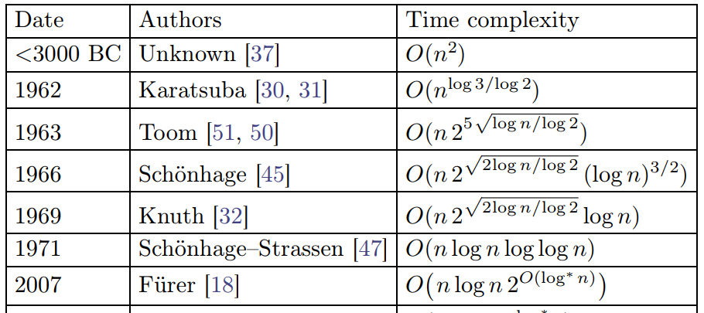

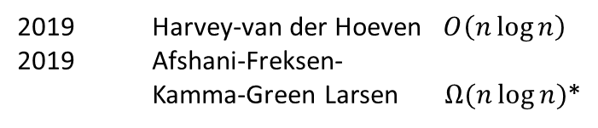
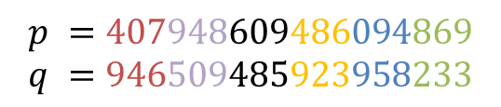









How fast can we multiply integers, really?
$$p_{l}$$
$$p_{l−1}$$
$$p_{1}$$
$$p_{0}$$
$$p =407948609486094869$$
$$q =946509485923958233$$
$p= \sum_{i=0}^{l}{p_{i}{10}^{ni/l}}$
$q= \sum_{i=0}^{l}{q_{i}{10}^{ni/l}}$
$r=\sum_{i=0}^{2l}{r_{i}{10}^{ni/l}}$
$r_{i}=\sum_{j=0}^{i}{p_{j}q_{i−j}}$
Reduces $n$-bit mults to only $\sum_{i=0}^{2l}{i}≈l⋅ log l$ times $n/l$ bit mults
$$q_{l}$$
$$q_{l−1}$$
$$q_{1}$$
$$q_{0}$$
Used in practice for
$$10000 < n < 40000$$
2019 Harvey-van der Hoeven $O\left(n\log{n}\right)$
2019 Afshani-Freksen-
Kamma-Green Larsen $Ω(n\log{n})$*

Slide 18
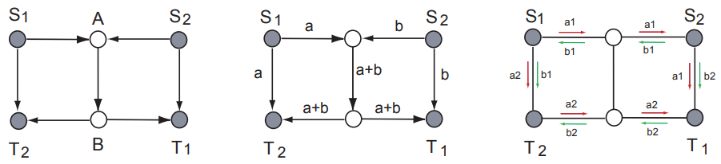

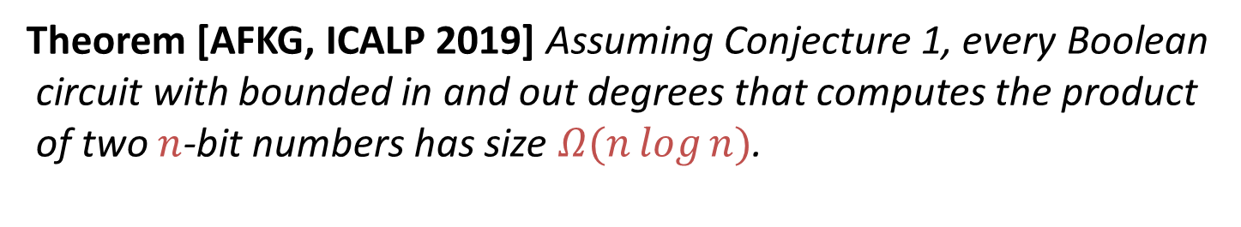
$Ω(n log n)$ lower bound
Network Coding Conjecture [Li&Li’04]:
The coding rate is never better than the multi-commodity flow rate,
in undirected graphs.
Theorem [AFKG, ICALP 2019] Assuming Conjecture 1, every Boolean
circuit with bounded in and out degrees that computes the product
of two $n$-bit numbers has size $Ω(n\log{n})$.

Slide 19
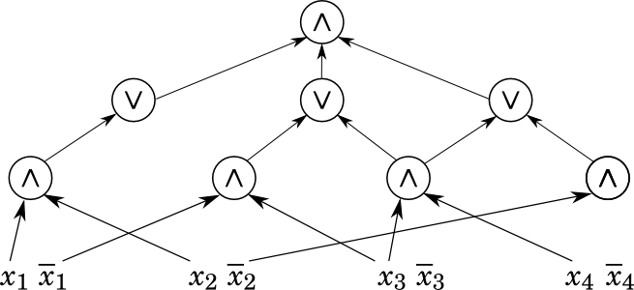

Slide 20
Addition
(Subset Sum)

Slide 21





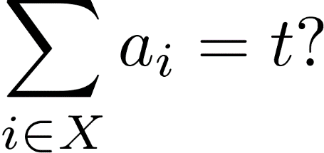
Subset Sum
Given: integers and integer
Asked: is there such that
NP-complete!

Slide 22
Subset Sum
Given: integers and integer
Asked: is there such that
NP-complete!
Example
{1 2 3 4 5 6 7 8 9 10 11 12}, = 50

Slide 23

Subset Sum
Given: integers and integer
Asked: is there such that
NP-complete!
Example
{1 2 3 4 5 6 7 8 9 10 11 12}, = 50

Slide 24


Subset Sum
Target:
There are 5 solutions!
For $i=1,…,n$ and $j=1,…,t$:
$T\left[i,j\right]≔|\{X⊆\{1,…,i\}: \sum_{e∈X}{a_{e}}\}|$
$T\left[0,0\right]=1$,
$T\left[0,j\right]=0$, if $j≠0$
$T\left[i,j\right] =T\left[i−1,j\right]+T[i−1,j−a_{i}]$
3 20 58 90 267 493 869 961
1000 1153 1246 1598 1766 1922

Slide 25

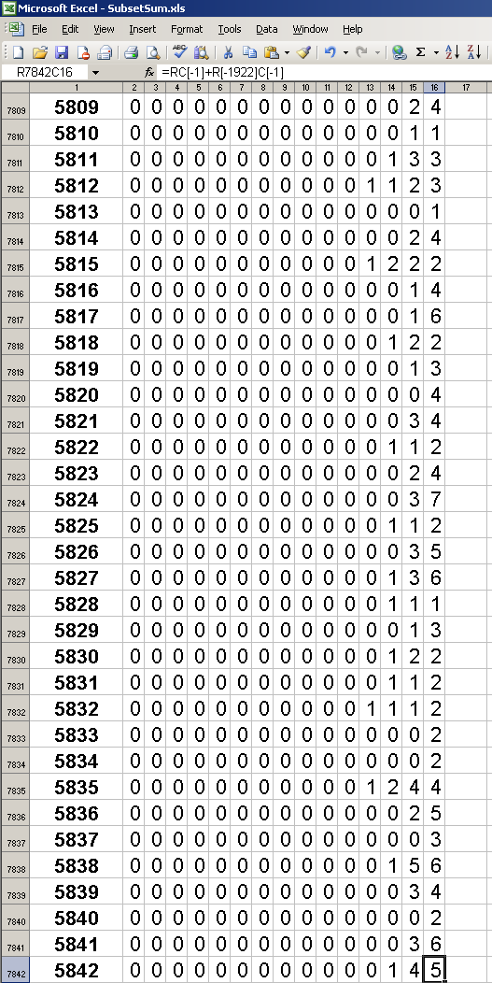

Subset Sum
Target:
There are 5 solutions!
For $i=1,…,n$ and $j=1,…,t$:
$T\left[i,j\right]≔|\{X⊆\{1,…,i\}: \sum_{e∈X}{a_{e}}\}|$
$T\left[0,0\right]=1$,
$T\left[0,j\right]=0$, if $j≠0$
$T\left[i,j\right] =T\left[i−1,j\right]+T[i−1,j−a_{i}]$
3 20 58 90 267 493 869 961
1000 1153 1246 1598 1766 1922

Slide 26
Dynamic Programming (DP)
Initiated in 1950's by Bellman in his book
"Bottleneck Problems and Dynamic Programming"
Nowadays one of most prominent algorithmic techniques in designing algorithms.
Discussed in any basic course or text book on algorithms

Slide 27
Dynamic Programming (DP)
The method works with a big table of data that has to be stored in the (preferably working) memory
A relatively easy procedure computes new table entries using already computed table entries
This easy procedure is often so easy that we just write it down as a single formula, obtaining a recurrence.

Slide 28

Subset Sum
Target:
There are 5 solutions!
For $i=1,…,n$ and $j=1,…,t$:
$T\left[i,j\right]≔|\{X⊆\{1,…,i\}: \sum_{e∈X}{a_{e}}=j\}|$
$T\left[0,0\right]=1$
$T\left[0,j\right]=0$, if $j≠0$
$T\left[i,j\right] =T\left[i−1,j\right]+T[i−1,j−a_{i}]$
3 20 58 90 267 493 869 961
1000 1153 1246 1598 1766 1922

Slide 29
 | 1 | 2 | ... | 14
0
1
2
3
4
5
6
7
8
9
10
...
5842 |  |  |  | ?

Slide 30
 | 1 | 2 | ... | 14
0
1
2
3
4
5
6
7
8
9
10
...
5842 |  |  |  | ?

Slide 31
 | 1 | 2 | ... | 14
0
1
2
3
4
5
6
7
8
9
10
...
5842 |  |  |  | ?

Slide 32
 | 1 | 2 | ... | 14
0
1
2
3
4
5
6
7
8
9
10
...
5842 |  |  |  | ?

Slide 33
 | 1 | 2 | ... | 14
0
1
2
3
4
5
6
7
8
9
10
...
5842 |  |  |  | ?

Slide 34
 | 1 | 2 | ... | 14
0
1
2
3
4
5
6
7
8
9
10
...
5842 |  |  |  | ?

Slide 35
 | 1 | 2 | ... | 14
0
1
2
3
4
5
6
7
8
9
10
...
5842 |  |  |  | ?

Slide 36
 | 1 | 2 | ... | 14
0
1
2
3
4
5
6
7
8
9
10
...
5842 |  |  |  | ?

Slide 37
 | 1 | 2 | ... | 14
0
1
2
3
4
5
6
7
8
9
10
...
5842 |  |  |  | ?

Slide 38
 | 1 | 2 | ... | 14
0
1
2
3
4
5
6
7
8
9
10
...
5842 |  |  |  | ?

Slide 39
 | 1 | 2 | ... | 14
0
1
2
3
4
5
6
7
8
9
10
...
5842 |  |  |  | ?

Slide 40
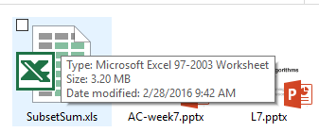
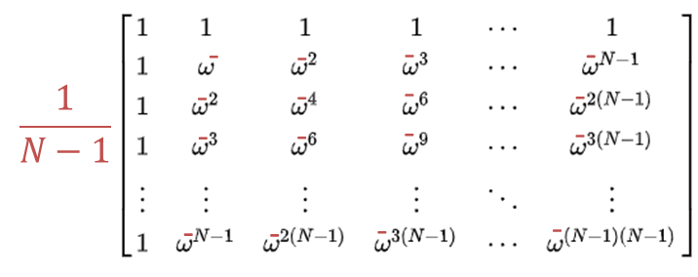




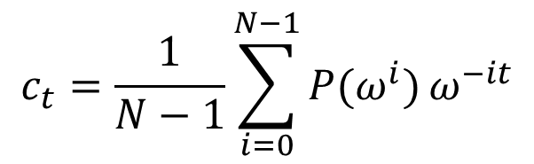



Subset Sum
Bellman 50’s: In $O(nt)$ time, $O(t)$ space
NP-complete: $t$ can be exponential in the input size!
Can we improve space usage?
LN’10: $O(n^{3}t)$ time, $O(n^{2}\log{t})$ space.
Idea: Determine coëfficiënt $c_{t}$ of $x^{t}$ in $P\left(x\right)≔\prod_{i=1}^{n}{(1+x^{a_{i}})}$
$$c_{t}=\frac{1}{N−1}\sum_{i=0}^{N−1}{P(ω^{i})}ω^{−it}$$
$$c_{1}$$
(
$$c_{1}$$
)
$$c_{t}$$
=
$$c_{t}$$
$$c_{N}$$
$$c_{N}$$

Slide 41
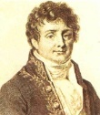




 | 1 | 2 | ... | 14
0
1
2
3
4
5
6
7
8
9
10
...
5842 |  |  |  | ?
=
R
$$−1$$
$$−1$$
$$−1$$
(
)
)
(
)
(
=
=
=
$$−1$$
=
R

Slide 42
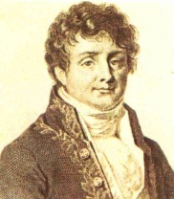
 | 1 | 2 | ... | 14
0
1
2
3
4
5
6
7
8
9
10
...
5842 |  |  |  | ?
 | 1 | 2 | ... | 14
0
1
2
3
4
5
6
7
8
9
10
...
5842
Apply

Slide 43
 | 1 | 2 | ... | 14
0
1
2
3
4
5
6
7
8
9
10
...
5842 |  |  |  | ?
 | 1 | 2 | ... | 14
0
1
2
3
4
5
6
7
8
9
10
...
5842
Apply

Slide 44
 | 1 | 2 | ... | 14
0
1
2
3
4
5
6
7
8
9
10
...
5842 |  |  |  | ?
 | 1 | 2 | ... | 14
0
1
2
3
4
5
6
7
8
9
10
...
5842
Apply
Apply
-1

Slide 45
 | 1 | 2 | ... | 14
0
1
2
3
4
5
6
7
8
9
10
...
5842 |  |  |  | ?
 | 1 | 2 | ... | 14
0
1
2
3
4
5
6
7
8
9
10
...
5842
Apply
Apply
-1

Slide 46
 | 1 | 2 | ... | 14
0
1
2
3
4
5
6
7
8
9
10
...
5842 |  |  |  | ?
 | 1 | 2 | ... | 14
0
1
2
3
4
5
6
7
8
9
10
...
5842
Apply
Apply
-1

Slide 47
 | 1 | 2 | ... | 14
0
1
2
3
4
5
6
7
8
9
10
...
5842 |  |  |  | ?
 | 1 | 2 | ... | 14
0
1
2
3
4
5
6
7
8
9
10
...
5842
Apply
Apply
-1

Slide 48
 | 1 | 2 | ... | 14
0
1
2
3
4
5
6
7
8
9
10
...
5842 |  |  |  | ?
 | 1 | 2 | ... | 14
0
1
2
3
4
5
6
7
8
9
10
...
5842
Apply
Apply
-1

Slide 49
 | 1 | 2 | ... | 14
0
1
2
3
4
5
6
7
8
9
10
...
5842 |  |  |  | ?
 | 1 | 2 | ... | 14
0
1
2
3
4
5
6
7
8
9
10
...
5842
Apply
Apply
-1

Slide 50
 | 1 | 2 | ... | 14
0
1
2
3
4
5
6
7
8
9
10
...
5842 |  |  |  | ?
 | 1 | 2 | ... | 14
0
1
2
3
4
5
6
7
8
9
10
...
5842
Apply
Apply
-1

Slide 51
 | 1 | 2 | ... | 14
0
1
2
3
4
5
6
7
8
9
10
...
5842 |  |  |  | ?
 | 1 | 2 | ... | 14
0
1
2
3
4
5
6
7
8
9
10
...
5842
Apply
Apply
-1

Slide 52
 | 1 | 2 | ... | 14
0
1
2
3
4
5
6
7
8
9
10
...
5842 |  |  |  | ?
 | 1 | 2 | ... | 14
0
1
2
3
4
5
6
7
8
9
10
...
5842
Apply
Apply
-1

Slide 53
Fourier transform for Subset Sum
This works because of two reasons:
  The fact that the transformation is invertible assures we can recover the required value from the transformed values.
  The fact that the dependence in the transformed table becomes simpler assures we gain something by using the transformation.
In general, many tricks for multiplying chain of (explicit) matrices quickly
  What if some of the matrices have low rank?

Slide 54
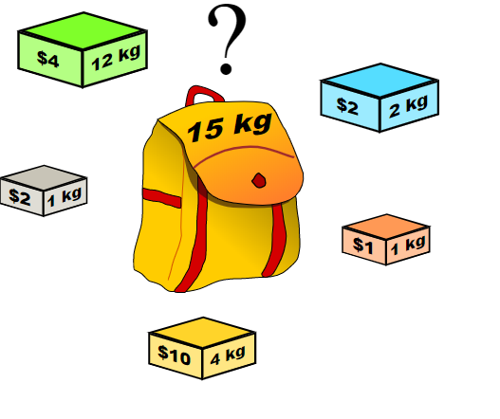
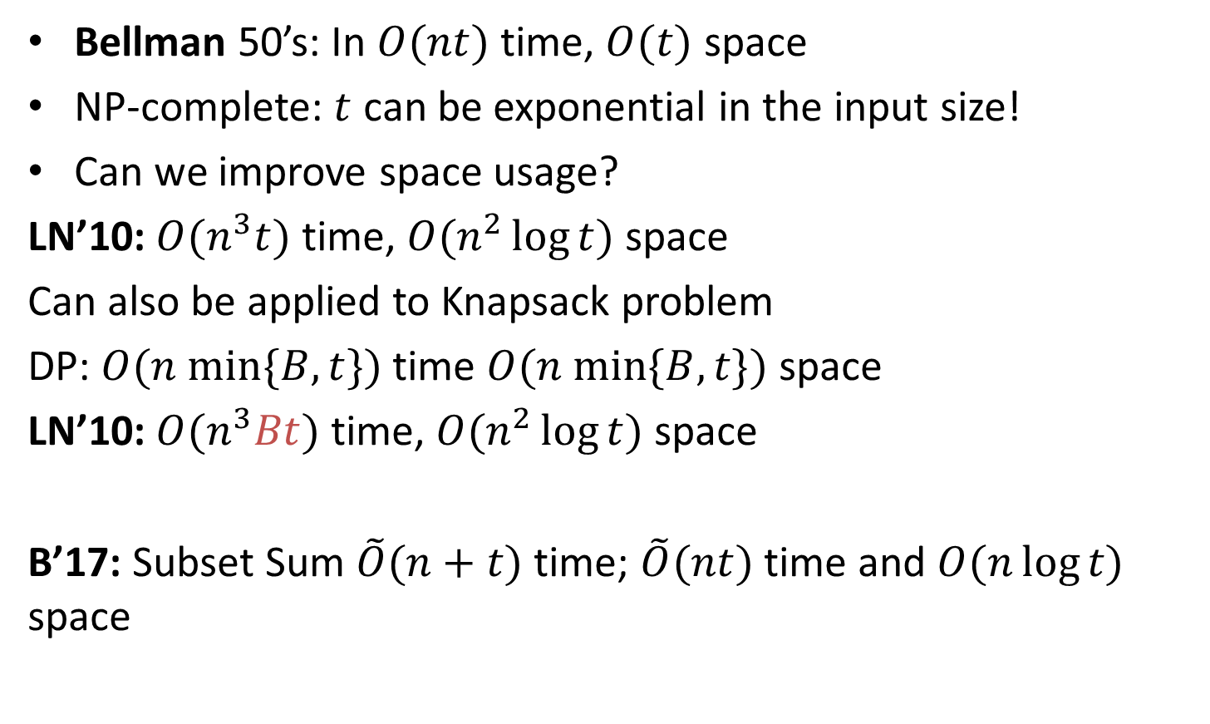
Subset Sum
Bellman 50’s: In $O(nt)$ time, $O(t)$ space
NP-complete: $t$ can be exponential in the input size!
Can we improve space usage?
LN’10: $O(n^{3}t)$ time, $O(n^{2}\log{t})$ space
Can also be applied to Knapsack problem
DP: $O(n min\{B,t\})$ time $O(n min⁡\{B,t\})$ space
LN’10: $O(n^{3}Bt)$ time, $O(n^{2}\log{t})$ space
B’17: Subset Sum $\tilde{O}(n+t)$ time; $\tilde{O}(nt)$ time and $O(n\log{t})$ space

Slide 55
Fast Linear Algebra

Slide 56
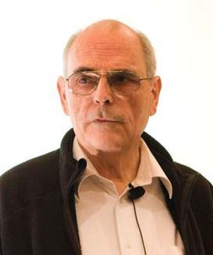
Matrix Multiplication
a | b
c | d
e | f
g | h
ae+bg | af+bh
ce+dg | cf+dh
X
=
Seems to require 8 multiplications.
Multiplying nxn matrices seems to take n³ multiplications.
  Was thought by researchers for a while as well
But then…. in 1969…… : n^{2.81} multiplications!
Volker Strassen

Slide 57
Matrix Multiplication
a | b
c | d
e | f
g | h
ae+bg | af+bh
ce+dg | cf+dh
X
=
=
M1: (a+d)(e+h)
M2: (c+d)e
M3: a(f-h)
M4: d(g-e)
M5: (a+b)*h
M6: (c-a)*(e+f)
M7: (b-d)*(g+h)
M1+M4-M5+M7 | M3+M5
M2+M4 | M1-M2+M3+M6

Slide 58
Matrix Multiplication
X
=

Slide 59
Matrix Multiplication
a₁₁ | a₁₂ | b₁₁ | b₁₂
a₂₁ | a₂₂ | b₂₁ | b₂₂
c₁₁ | c₁₂ | d₁₁ | d₁₂
c₂₁ | c₂₂ | d₂₁ | d₂₂
A | B
C | D
e₁₁ | e₁₂ | f₁₁ | f₁₂
e₂₁ | e₂₂ | f₂₁ | f₂₂
g₁₁ | g₁₂ | h₁₁ | h₁₂
g₂₁ | g₂₂ | h₂₁ | h₂₂
E | F
G | H
AE+FG | AF+BH
CE+DG | CF+DH
X
=
=
M1: (A+D)(E+H)
M2: (C+D)E
M3: A(F-H)
M4: D(G-E)
M5: (A+B)*H
M6: (C-A)*(E+F)
M7: (B-D)*(G+H)
M1+M4-M5+M7 | M3+M5
M2+M4 | M1-M2+M3+M6

Slide 60
Matrix Multiplication
a₁₁ | a₁₂ | b₁₁ | b₁₂
a₂₁ | a₂₂ | b₂₁ | b₂₂
c₁₁ | c₁₂ | d₁₁ | d₁₂
c₂₁ | c₂₂ | d₂₁ | d₂₂
A | B
C | D
e₁₁ | e₁₂ | f₁₁ | f₁₂
e₂₁ | e₂₂ | f₂₁ | f₂₂
g₁₁ | g₁₂ | h₁₁ | h₁₂
g₂₁ | g₂₂ | h₂₁ | h₂₂
E | F
G | H
AE+FG | AF+BH
CE+DG | CF+DH
X
=
1 mult of 4x4 matrices -> 7 mult’s of 2x2 matrices ->
49 multiplications of numbers
1 mult of nxn matrices ->
7^{lg(n)}=2^{lg(7)*lg(n)}=n^{lg(7)}=n^{2.81} multiplications of numbers.

Slide 61
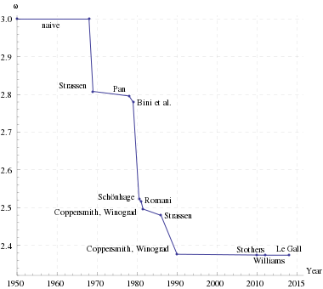
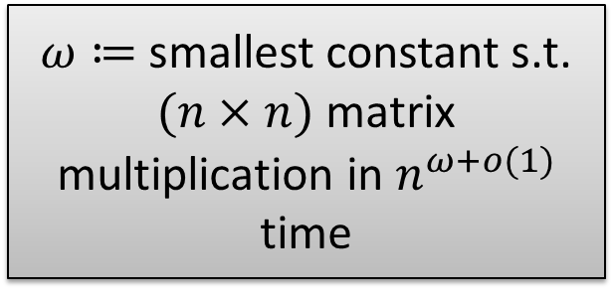
Other Linear Algebra
$ω≔$ smallest constant s.t. $(n×n)$ matrix multiplication in $n^{ω+o(1)}$ time

Slide 62
Group-Theoretic Matrix Mult
Natural idea, reduce to some polynomial multiplication
Cohn, Umans (and others):
  Rephrases existing algorithms as embedding matrix mult in general polynomial multiplication
  (group algebra’s)

Slide 63


Other Linear Algebra
* This exposition is heavily based on a blog post (see notes)
Lots of linear algebra in $n^{ω}$ time
Given $A$, can* find $LU$ decomposition in $n^{ω}$ time
$\det\left(LU\right)=det\left(L\right)\det\left(U\right)=\prod_{i}{L[i,i]}\prod_{i}{L[i,i]}$
=
$$⋅$$
Notes:
Pictures and explanation based on http://renatoppl.com/blog/2014/08/12/solving-linear-systems-and-inverting-a-matrix-is-equivalent-to-matrix-multiplication/

Slide 64
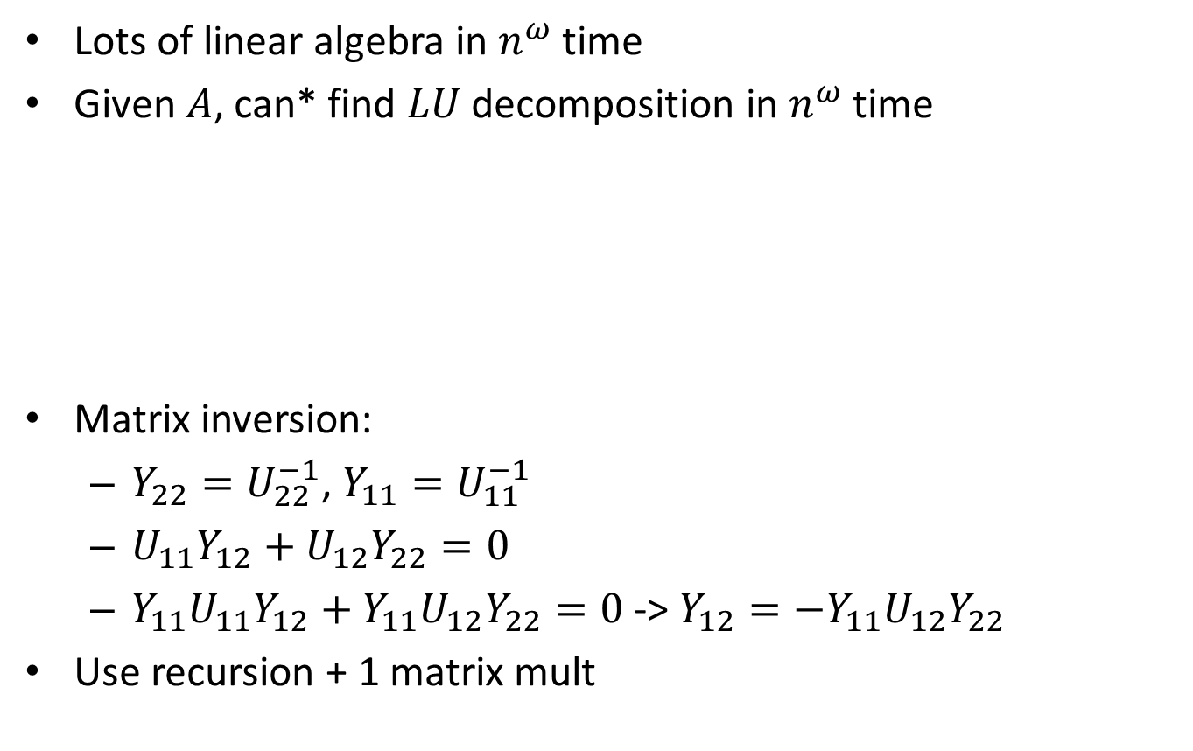
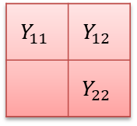
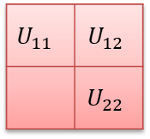
Other Linear Algebra
* This exposition is heavily based on a blog post (see notes)
Lots of linear algebra in $n^{ω}$ time
Given $A$, can* find $LU$ decomposition in $n^{ω}$ time
Matrix inversion:
  $Y_{22}=U_{22}^{−1}$, $Y_{11}=U_{11}^{−1}$
  $U_{11}Y_{12}+U_{12}Y_{22}=0$
  $Y_{11}U_{11}Y_{12}+Y_{11}U_{12}Y_{22}=0$ -> $Y_{12}=−Y_{11}U_{12}Y_{22}$
Use recursion + 1 matrix mult
=
$$⋅$$
X
=
$$U_{11}$$ | $$U_{12}$$
 | $$U_{22}$$
$$Y_{11}$$ | $$Y_{12}$$
 | $$Y_{22}$$
I
 | I
Notes:
Pictures and explanation based on http://renatoppl.com/blog/2014/08/12/solving-linear-systems-and-inverting-a-matrix-is-equivalent-to-matrix-multiplication/

Slide 65
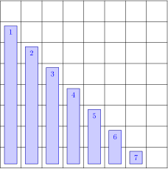
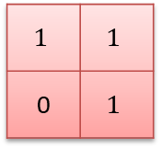
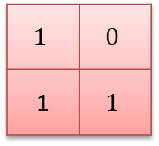
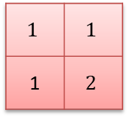
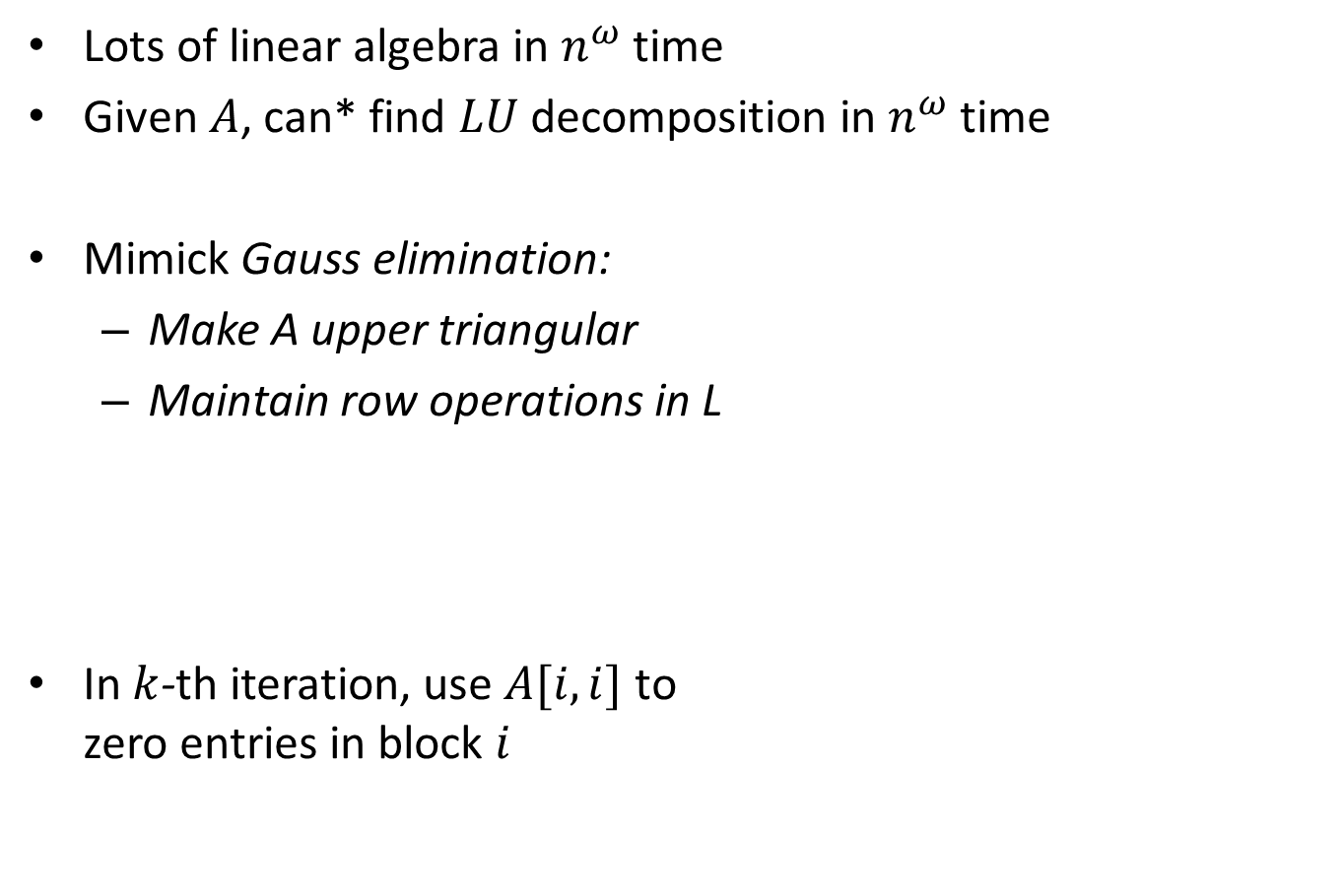
Other Linear Algebra
* This exposition is heavily based on a blog post (see notes)
Lots of linear algebra in $n^{ω}$ time
Given $A$, can* find $LU$ decomposition in $n^{ω}$ time
Mimick Gauss elimination:
  Make A upper triangular
  Maintain row operations in L
In $k$-th iteration, use $A[i,i]$ to
zero entries in block $i$
=
$$1$$ | $$1$$
1 | $$2$$
$$1$$ | $$0$$
1 | $$1$$
X
$$1$$ | $$1$$
0 | $$1$$
Notes:
Pictures and explanation based on http://renatoppl.com/blog/2014/08/12/solving-linear-systems-and-inverting-a-matrix-is-equivalent-to-matrix-multiplication/

Slide 66
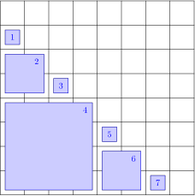
Other Linear Algebra
* This exposition is heavily based on a blog post (see notes)
Lots of linear algebra in $n^{ω}$ time
Given $A$, can* find $LU$ decomposition in $n^{ω}$ time
Mimick Gauss elimination:
  Make A upper triangular
  Maintain row operations in L
In $k$-th iteration, use $A[i,i]$ to
zero entries in block $i$
=
$$1$$ | $$1$$
1 | $$2$$
$$1$$ | $$0$$
1 | $$1$$
X
$$1$$ | $$1$$
0 | $$1$$
Notes:
Pictures and explanation based on http://renatoppl.com/blog/2014/08/12/solving-linear-systems-and-inverting-a-matrix-is-equivalent-to-matrix-multiplication/

Slide 67
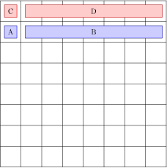

Other Linear Algebra
* This exposition is heavily based on a blog post (see notes)
Lots of linear algebra in $n^{ω}$ time
Given $A$, can* find $LU$ decomposition in $n^{ω}$ time
$\left[A,B\right]←\left[A,B\right]−AC^{−1}[C,D]$
Notes:
Pictures and explanation based on http://renatoppl.com/blog/2014/08/12/solving-linear-systems-and-inverting-a-matrix-is-equivalent-to-matrix-multiplication/

Slide 68
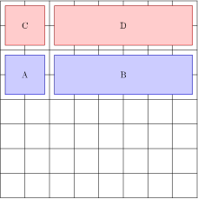
Other Linear Algebra
* This exposition is heavily based on a blog post (see notes)
Lots of linear algebra in $n^{ω}$ time
Given $A$, can* find $LU$ decomposition in $n^{ω}$ time
$\left[A,B\right]←\left[A,B\right]−AC^{−1}[C,D]$
Notes:
Pictures and explanation based on http://renatoppl.com/blog/2014/08/12/solving-linear-systems-and-inverting-a-matrix-is-equivalent-to-matrix-multiplication/

Slide 69
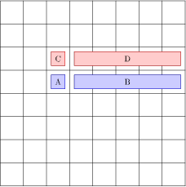
Other Linear Algebra
* This exposition is heavily based on a blog post (see notes)
Lots of linear algebra in $n^{ω}$ time
Given $A$, can* find $LU$ decomposition in $n^{ω}$ time
$\left[A,B\right]←\left[A,B\right]−AC^{−1}[C,D]$
Notes:
Pictures and explanation based on http://renatoppl.com/blog/2014/08/12/solving-linear-systems-and-inverting-a-matrix-is-equivalent-to-matrix-multiplication/

Slide 70
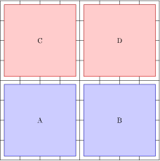
Other Linear Algebra
* This exposition is heavily based on a blog post (see notes)
Lots of linear algebra in $n^{ω}$ time
Given $A$, can* find $LU$ decomposition in $n^{ω}$ time
$\left[A,B\right]←\left[A,B\right]−AC^{−1}[C,D]$
Notes:
Pictures and explanation based on http://renatoppl.com/blog/2014/08/12/solving-linear-systems-and-inverting-a-matrix-is-equivalent-to-matrix-multiplication/

Slide 71
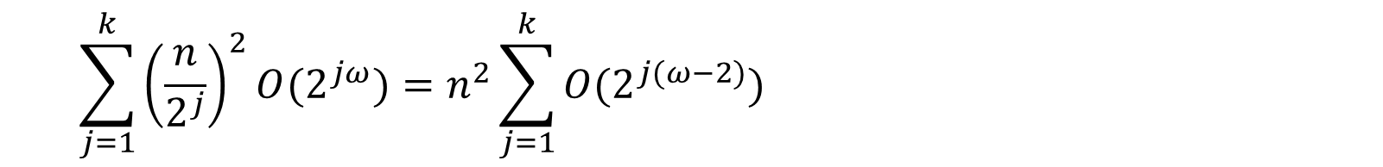

Other Linear Algebra
* This exposition is heavily based on a blog post (see notes)
Lots of linear algebra in $n^{ω}$ time
Given $A$, can* find $LU$ decomposition in $n^{ω}$ time
$\left[A,B\right]←\left[A,B\right]−AC^{−1}[C,D]$
Say $n=2^{k}$. For $j=1,…k−1$:
${n/2}^{j}$ iterations with $2^{j}×2^{j}$ blocks,
  Inverting: $2^{jω}$
  mult $2^{j}×2^{j}$ with $2^{j}×n$ matrix
  Takes $n/2^{j}∗O(2^{jω})$ time
Total runtime:
$$\sum_{j=1}^{k}{{\left(\frac{n}{2^{j}}\right)}^{2}O(2^{jω})}=n^{2}\sum_{j=1}^{k}{O(2^{j(ω−2)})}$$
Notes:
Pictures and explanation based on http://renatoppl.com/blog/2014/08/12/solving-linear-systems-and-inverting-a-matrix-is-equivalent-to-matrix-multiplication/

Slide 72




Other Linear Algebra
* This exposition is heavily based on a blog post (see notes)
Natural question: can we do some tasks faster?
No for matrix inversion:
$$−1$$
$$I$$ | $$A$$ | $$0$$
$$0$$ | $$I$$ | $$B$$
$$0$$ | $$0$$ | $$I$$
$$I$$ | $$−A$$ | $$AB$$
$$0$$ | $$I$$ | $$−B$$
$$0$$ | $$0$$ | $$I$$
$$=$$
Notes:
Pictures and explanation based on http://renatoppl.com/blog/2014/08/12/solving-linear-systems-and-inverting-a-matrix-is-equivalent-to-matrix-multiplication/

Slide 73

Other Linear Algebra
Natural question: can we do some tasks faster?
What about determinant?
Baur-Strassen:
Given a `straight-line’ program
for f$\left(x_{1},…,x_{n}\right)$ in time T, can
compute all partial derivatives
$\frac{∂f}{∂x_{1}},…,\frac{∂f}{{∂x}_{n}}$ in time 3T.
*
-
*
*
+
-
x₁
x₂
x₃
…
x_{n}

Slide 74



Other Linear Algebra
Natural question: can we do some tasks faster?
What about determinant?
Baur-Strassen:
Given a `straight-line’ program
for f$\left(x_{1},…,x_{n}\right)$ in time T, can
compute all partial derivatives
$\frac{∂f}{∂x_{1}},…,\frac{∂f}{{∂x}_{n}}$ in time 3T.
$C_{ij}=−1^{i+j}det(A_{ij})$,
$A_{ij}$ is $A$ minus row $i$ and column $j$

Slide 75


Other Linear Algebra
Natural question: can we do some tasks faster?
What about determinant?
Determinant is in `NC’ [Csanky’76]
NC: `Nick’s Class, named after Nick Pippenger by Stephen Cook’
The problem can be solved in $\log^{c}{n}$ time with $n^{k}$ processors,
for constants $c$ and $k$.

Slide 76
Freivalds’ Algorithm (1977)
Freivalds’ variant of problem:
Determine whether n × n matrices A, B, and C satisfy the condition AB = C
Method:
  Choose x ∈ {0,1}^{n} randomly and uniformly (vector of length n)
  If ABx ≠ Cx then report “AB ≠ C”
  else report “AB = C probably”

Slide 77
Running Time
ABx = A(Bx), so we have 3 instances of an n × n matrix times an n-vector
These are O(n²) time operations if done straightforwardly
Total running time O(n²)

Slide 78
How Often Is It Wrong?
P(ABx = Cx | AB = C) = 1
P(ABx = Cx | AB ≠ C) ≤ ½ :
Assume AB ≠ C
Then AB - C ≠ 0, so there exist i, j with (AB - C)_{ij} ≠ 0
Let (d₁, d₂, …, d_{n}) be i-th row of AB - C; d_{j} ≠ 0
P((AB - C) x = 0 | AB ≠ C)
≤ P($\sum_{i=1}^{n}{\text{d}\text{i} \text{x}\text{i}}$ = 0 | AB ≠ C)
= P(x_{j} = − $\frac{1}{\text{d}\text{j}}$ $\sum_{i≠j}{\text{d}\text{i} \text{x}\text{i}}$ | AB ≠ C)
≤ ½

Slide 79
Decreasing the Probability of Error
By iterating with k random, independent choices of x, we can decrease probability of error to 1/2^{k}, using time O(kn²)

Slide 80

Yates’ Algorithm
Kronecker power:
Suppose $A$ has rows $R$ and columns $C$
Let $k$ be an integer
Then $A^{⊗k}$ has rows $R^{k}$ and columns $C^{k}$
$A^{⊗k}\left[{(R}_{1},…,R_{k}\right),(C_{1},…C_{k})]=\prod_{i}{A[R_{i},C_{i}]}$
Yates’37: Given $A$, $k$, and vector $v∈𝔽^{C^{k}}$,
can compute $A^{⊗k}v$ in time
$O(\left|R\right|+{\left|C\right|)}^{ω}+{\left|C\right|}^{k})$ time.

